Slide 1
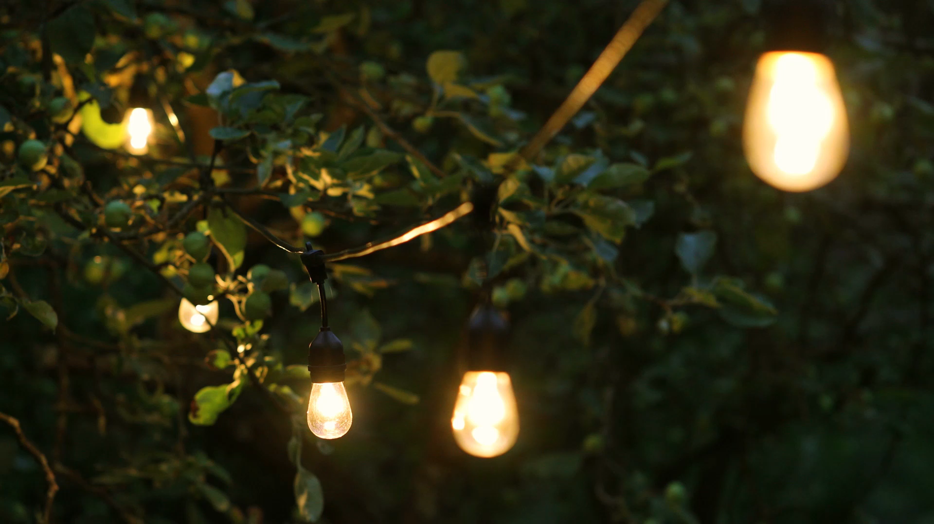
Lights
Lecturer : Tanaboon Tongbuasirilai
Course : ICCS404
Week 6 : Light and color

Slide 2
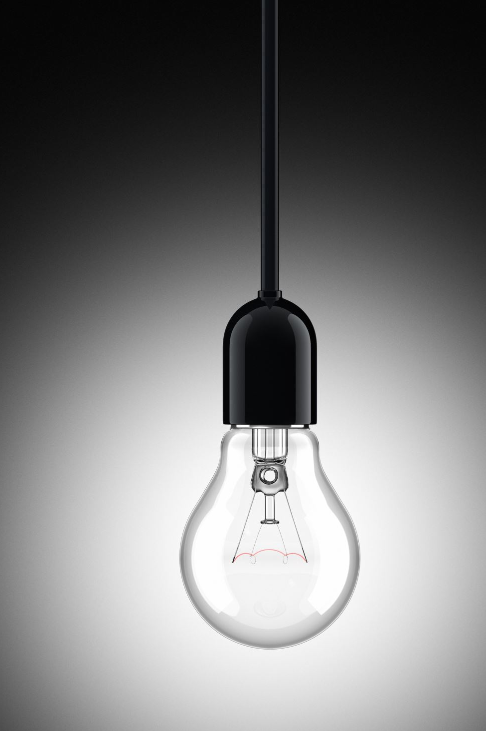
Sources of lighting
Single Light Source Limitation
So far, lighting has been from a single point source, but real-world lighting involves multiple types of light sources, each with distinct behaviors.
Light Caster
A light caster is any source of light that illuminates objects in a scene.
Types of Light Casters
Directional Light: Simulates distant light sources like the sun, casting parallel rays across objects.
Point Light: Extends the single point light source used earlier, casting light in all directions from a specific point.
Spotlight: A focused light source that emits light in a cone shape, illuminating only specific areas.
Enriching Environments
Simulating different light types allows for more realistic and dynamic lighting in scenes.
Combining Light Sources
In the next step, different types of lights (directional, point, and spotlights) will be combined into a single scene for more complex lighting setups.

Slide 3
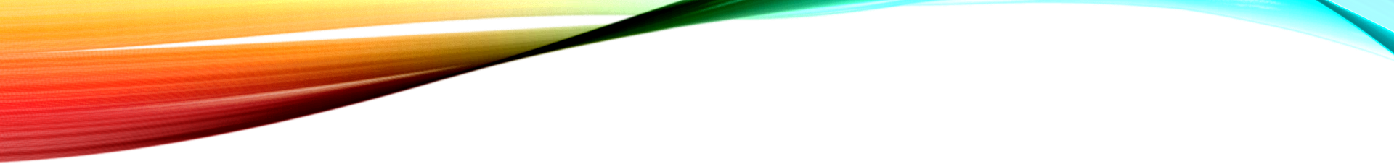

Light sources
Directional Light
Point Light
Spotlight
Notes:
We will go through 3 light sources.

Slide 4
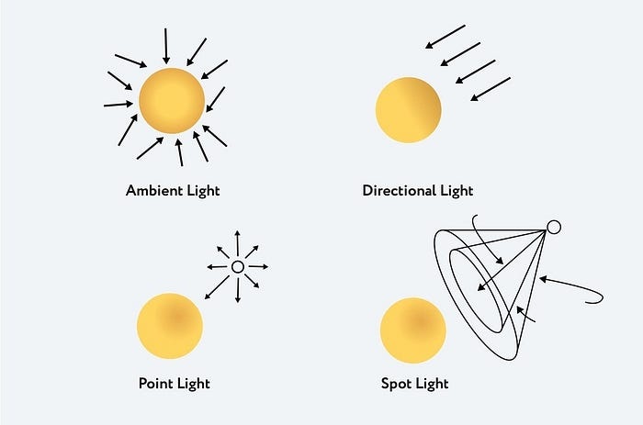
https://medium.com/@althafkhanbecse/title-enlightening-3d-worlds-mastering-lighting-techniques-in-three-js-c860caa8cdcf

Slide 5
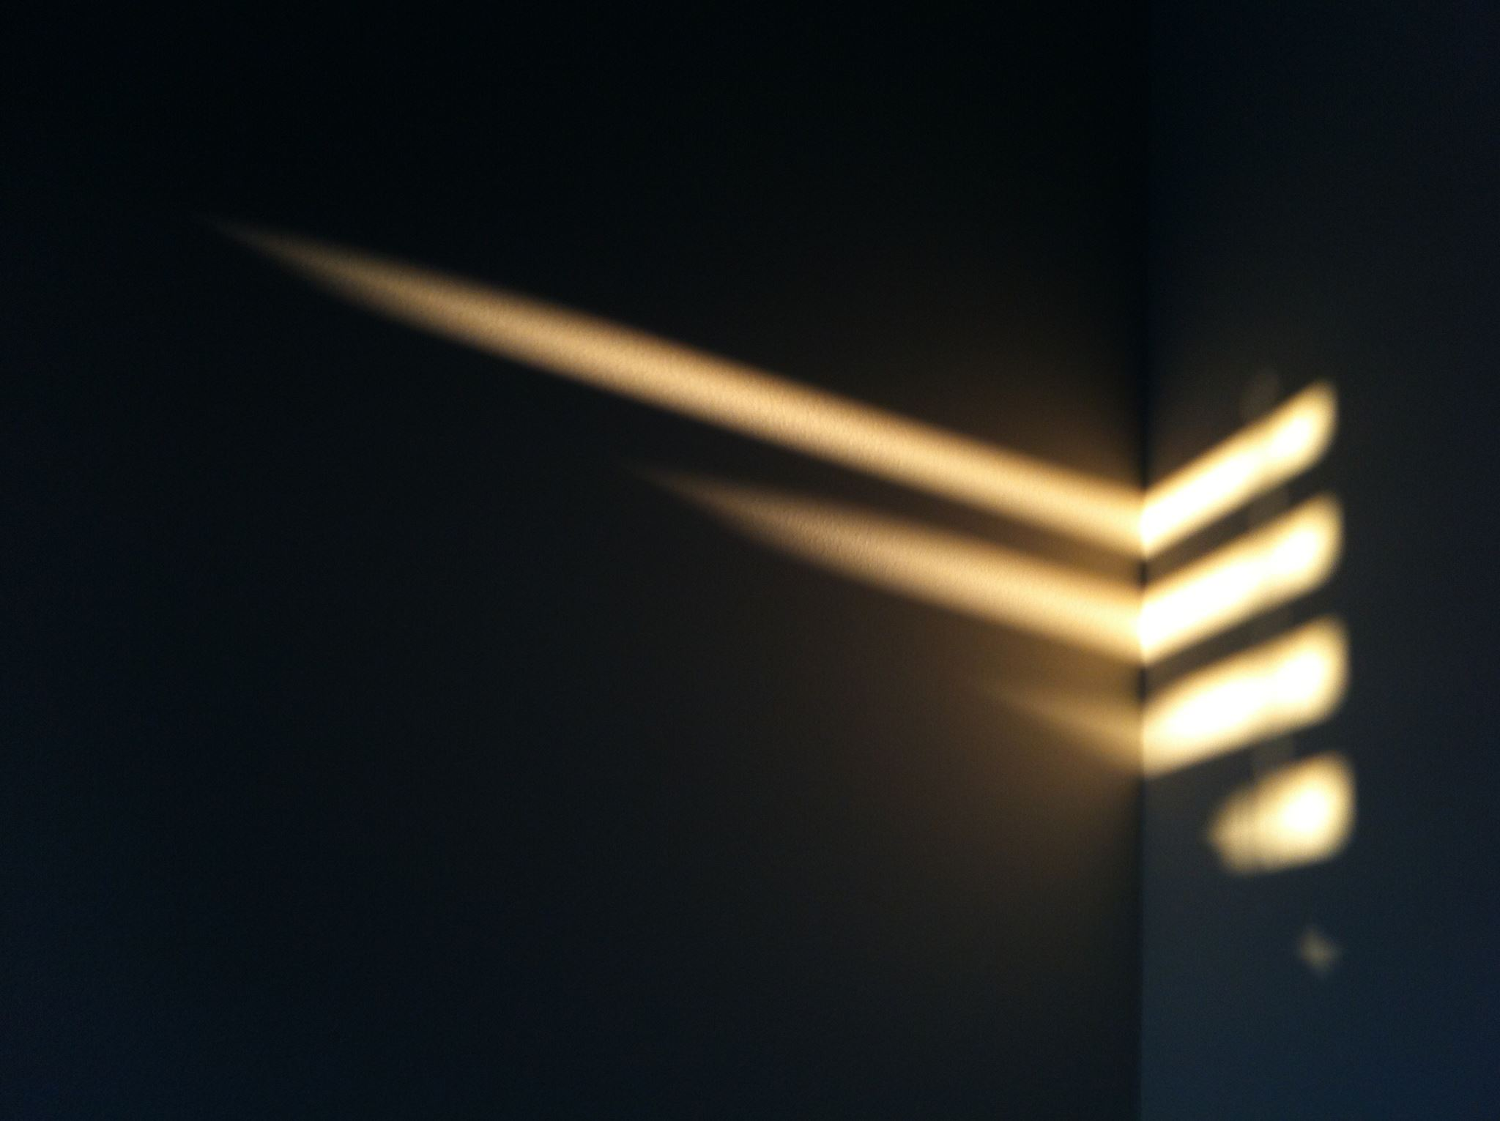
Directional lights
Parallel Light Rays
When a light source is far away, its rays are nearly parallel, making it appear as if all light comes from the same direction regardless of object or viewer position.
Directional Light
A directional light models a light source as infinitely far away, with all rays traveling in the same direction.
The light's position is irrelevant, only the direction matters.
Example: The Sun
The sun, while not infinitely distant, can be approximated as a directional light since its rays are effectively parallel in lighting calculations.
Consistent Lighting Across Objects
Since all rays are parallel, the light direction remains constant for every object in the scene, leading to similar lighting calculations across the scene.
Notes:
properties
1. parallel
2. A single direction
3. Consistent across objects in the scene.

Slide 6
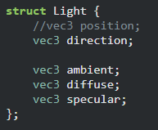
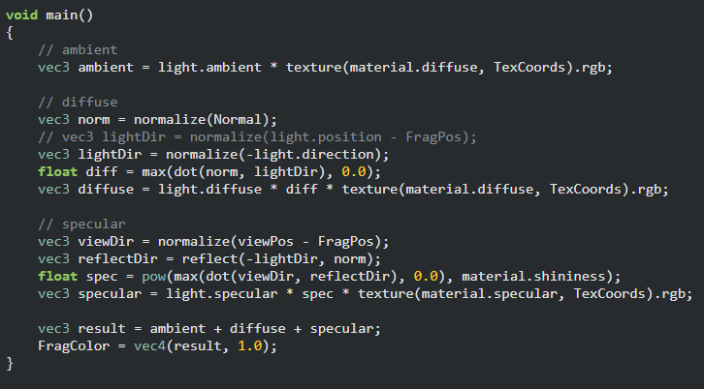
Defining a light direction in the fragment shader
Instead of calculating a light direction per fragment, we obtain the directional light direction from the core application.
Notes:
The negation depends on how we set the direction inward or outward.

Slide 7
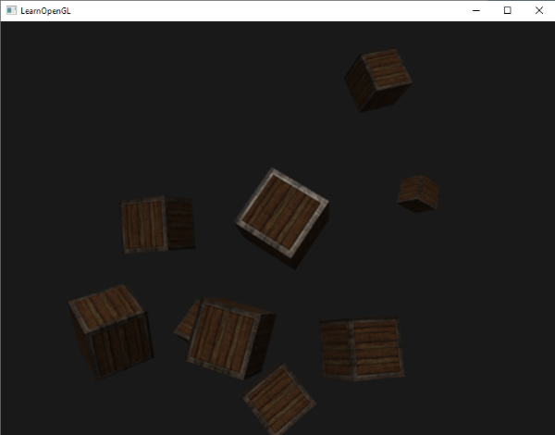
result
https://learnopengl.com/code_viewer_gh.php?code=src/2.lighting/5.1.light_casters_directional/light_casters_directional.cpp
Notes:
10 containers randomly distributed in the scene lit up with directional light.

Slide 8
When to use a directional light
Simulating Sunlight
When creating outdoor environments, especially daytime scenes, directional lights are ideal for simulating the sun’s lighting because sunlight can be approximated as parallel rays.
Large-Scale Scenes
For large open-world environments or wide outdoor scenes where the light source needs to affect all objects equally, directional light is perfect since its rays affect all objects uniformly, regardless of their location.
Consistent Lighting Across the Scene
If you need consistent lighting across a scene (e.g., lighting a large group of objects or landscapes uniformly), directional light provides this without requiring a specific position for the light source.
Ignoring Light Position
When the exact position of the light source doesn’t matter and only the direction of light is important, directional light simplifies the setup by focusing on the direction rather than the location.
Efficient Lighting for Large Surfaces
For environments that span a wide area, directional lights provide efficient and simple lighting without the complexity of adjusting for distance attenuation (as with point lights).
Notes:
Directional lights are best used when you want to simulate a distant, uniform light source that illuminates an entire scene evenly.

Slide 9
Point lights
Point Lights for Local Illumination
Point lights are ideal for illuminating specific areas in a scene. They have a fixed position and emit light in all directions, like a light bulb or torch.
Light Attenuation
Point lights are designed to have their intensity fade out over distance, mimicking real-world light behavior. Without attenuation, distant objects appear as bright as those near the light source, which looks unrealistic.
Previous Setup (No Attenuation)
In earlier examples, the point light had no fading, causing all objects in the scene to be illuminated equally, regardless of distance from the light source.
Realistic Lighting
For more realistic effects, point lights should gradually reduce their intensity with distance, so that nearby objects are brightly lit while distant ones are dimmer, simulating real-world light falloff.
Application in 3D Scenes
When adding multiple objects to a scene, point lights should focus on illuminating areas close to the light source, not the entire scene equally.

Slide 10
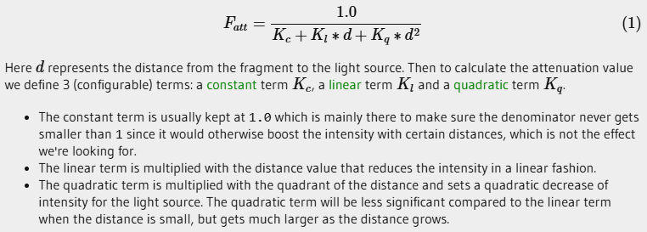
Mathematics of attenuation

Slide 11
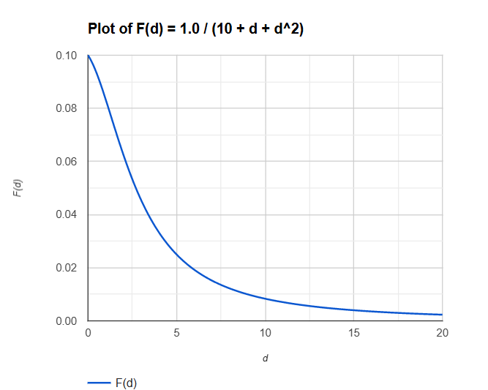
Quadratic Attenuation term

Slide 12
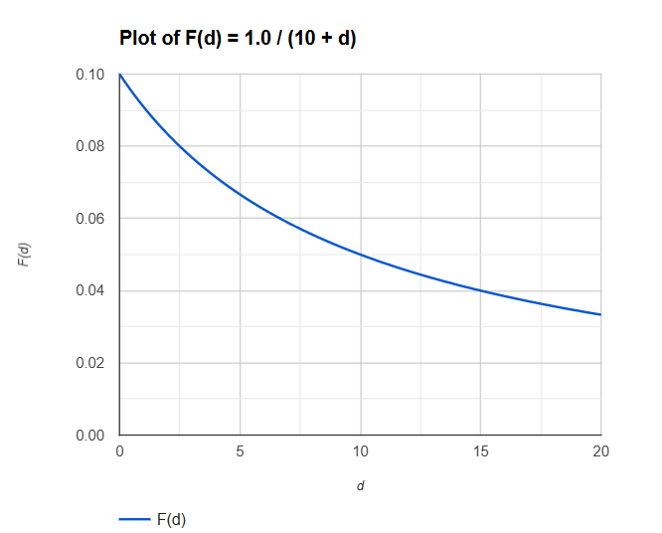
Linear Attenuation term

Slide 13
Light attenuation
Attenuation
Attenuation refers to the reduction of light intensity as it travels over distance.
Linear Attenuation
A simple linear equation can reduce light intensity over distance, but this approach often appears unrealistic.
Real-World Light Behavior
In reality, light remains bright at close range, loses intensity quickly at a distance, and then slowly diminishes over longer distances.
Quadratic Attenuation
A quadratic attenuation model better mimics real-world lighting. The light intensity decreases at a linear rate initially, then drops off more rapidly as distance increases.
Desired Effect
The quadratic formula creates a realistic effect where light is intense when close but fades naturally over distance, eventually reaching zero intensity.

Slide 14
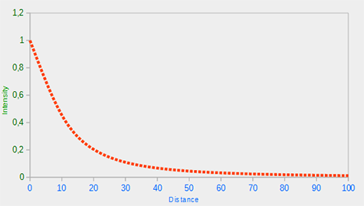
Light intensity over distance

Slide 15
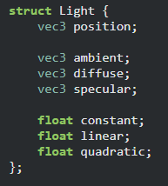
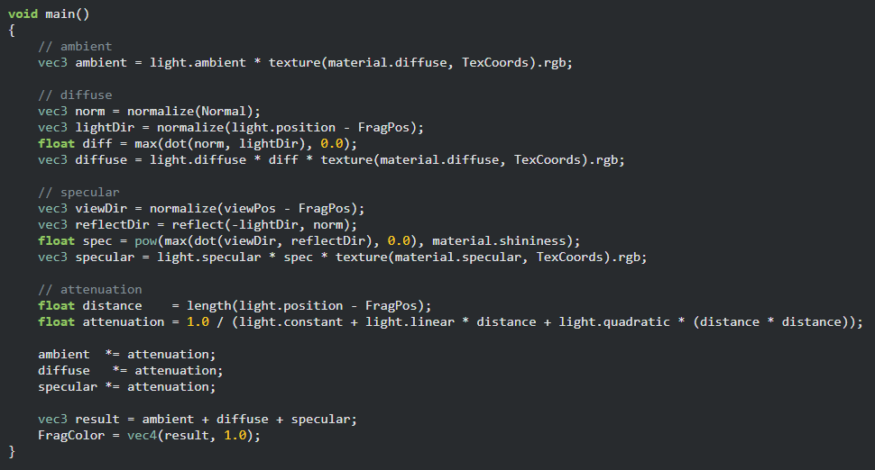
Implementing light attenuation

Slide 16
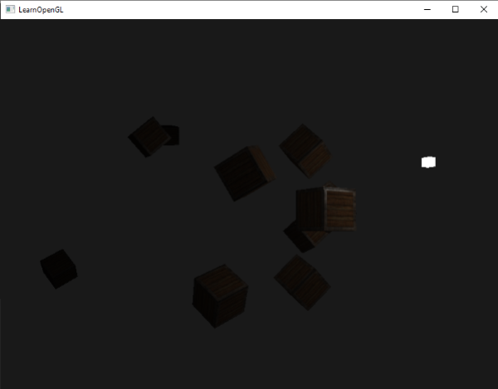
result
https://learnopengl.com/code_viewer_gh.php?code=src/2.lighting/5.2.light_casters_point/light_casters_point.cpp

Slide 17
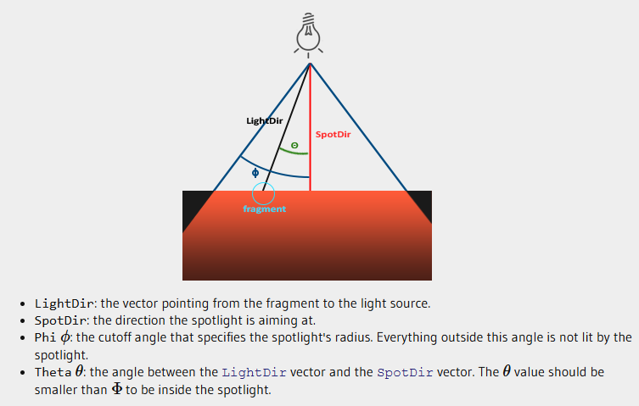
spotlight

Slide 18
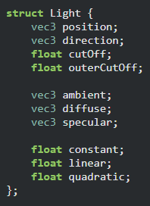
Setup a flashlight (spotlight)
A flashlight also has attenuation

Slide 19
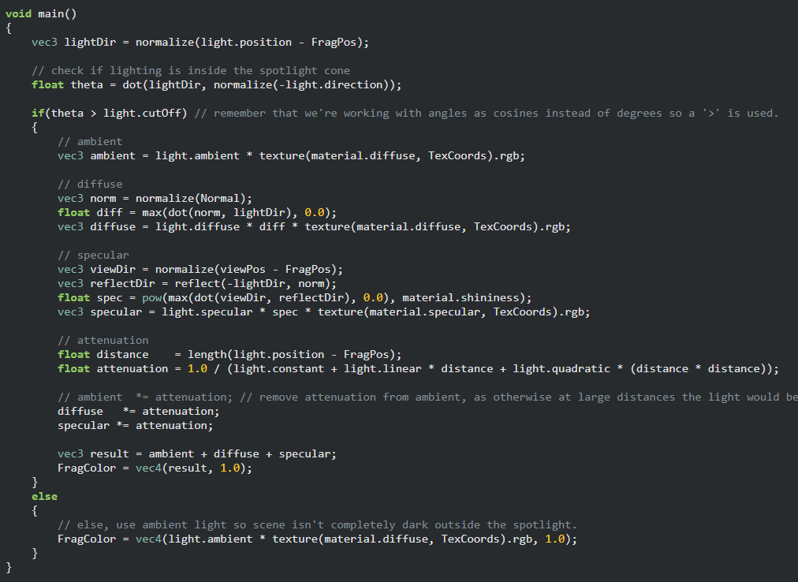
Compute a light direction per fragment.
Find theta – It’s a cosine term.
Check if the fragment is inside the flashlight area.
If it falls outside, we set it to ambient color.
Notes:
To speed up the computation, we compare the cosine values instead of the angles.

Slide 20
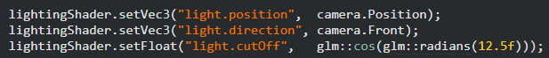
Speed up the calculation

Slide 21
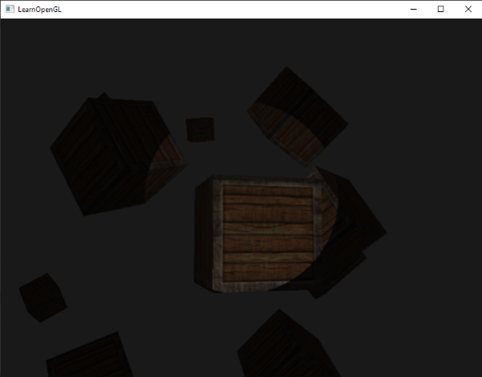
result
https://learnopengl.com/code_viewer_gh.php?code=src/2.lighting/5.3.light_casters_spot/light_casters_spot.cpp

Slide 22
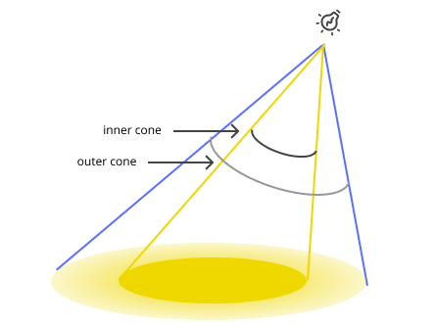
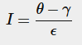
a smoothly-edged spotlight
The angle between fragment and light direction.
The outer cone angle.
Difference between inner and outer cone.

Slide 23
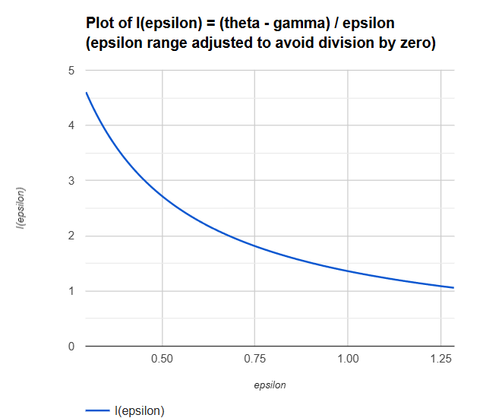
Smoothly-edge curve

Slide 24
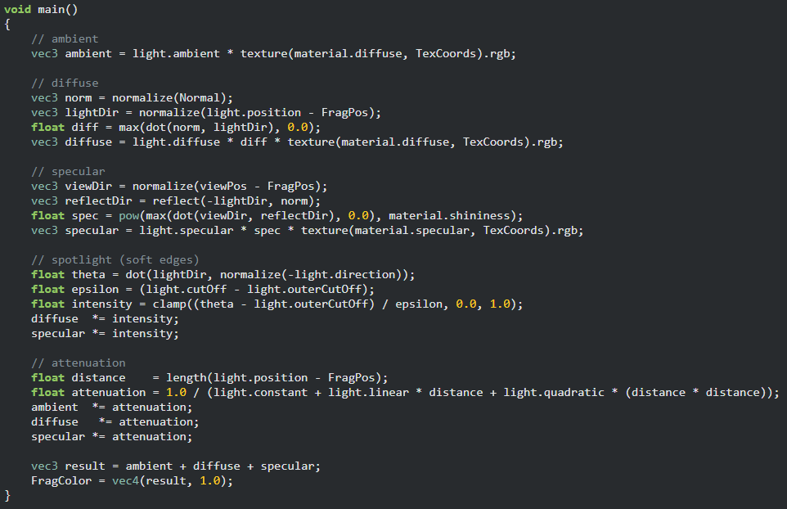
No if-else statement needed.
The intensity is in range (0,1].

Slide 25
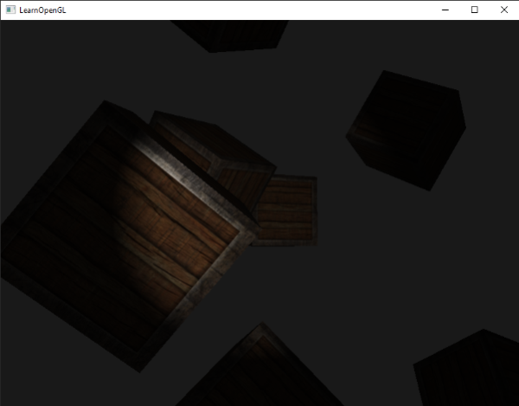
result
https://learnopengl.com/code_viewer_gh.php?code=src/2.lighting/5.4.light_casters_spot_soft/light_casters_spot_soft.cpp

